Slide 1
Who Am I? -
Exploring My Social Identity
Erica Grindinger
SPD: 874
Dr. Deborah Griswold
June 7, 2025

Slide 2
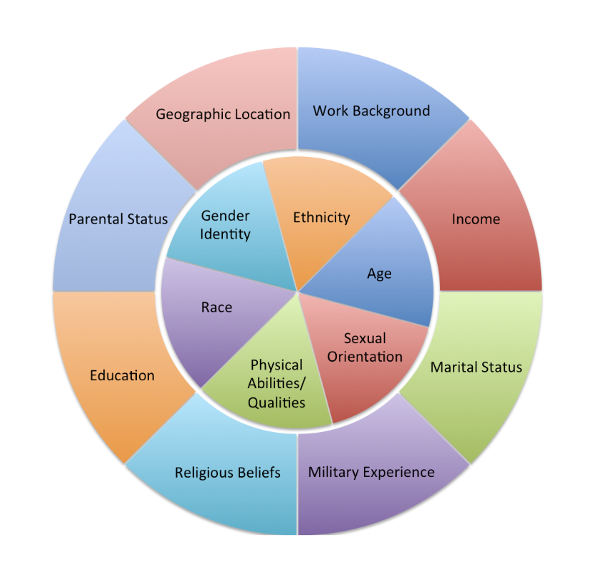
Introduction to Identity
Understanding who we are helps us collaborate effectively and helps us teach with empathy. Our identities are made up of many factors — some visible, some hidden — both shape how we see the world and interact with others.

Slide 3
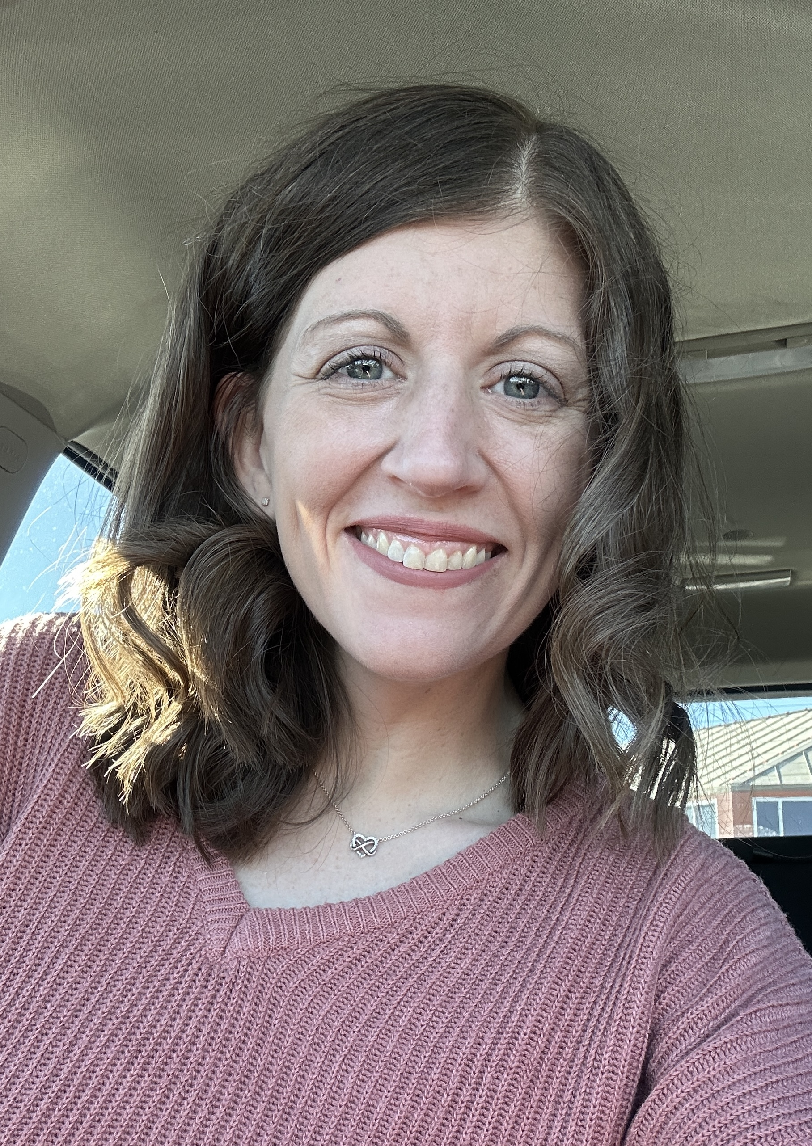
Identity Breakdown
Each factor in these rings influence my perspective and how I approach teaching and collaboration. Some factors are within my control, and some are out of my control, but it shapes me just the same.

Slide 4

Geographic Location
Kansas City
Whether it is through sports, BBQ, or tragedy, this city has taught me the importance of community support and belonging, which I emphasize in my teaching by fostering a classroom environment where every student feels connected and valued. This is the city where I decided I wanted to become an educator.

Slide 5



Education
My educational journey has shaped my belief in lifelong learning. (One day they will call me Dr. G!). I strive to model curiosity and perseverance in the classroom and encourage collaboration through shared knowledge and growth.

Slide 6
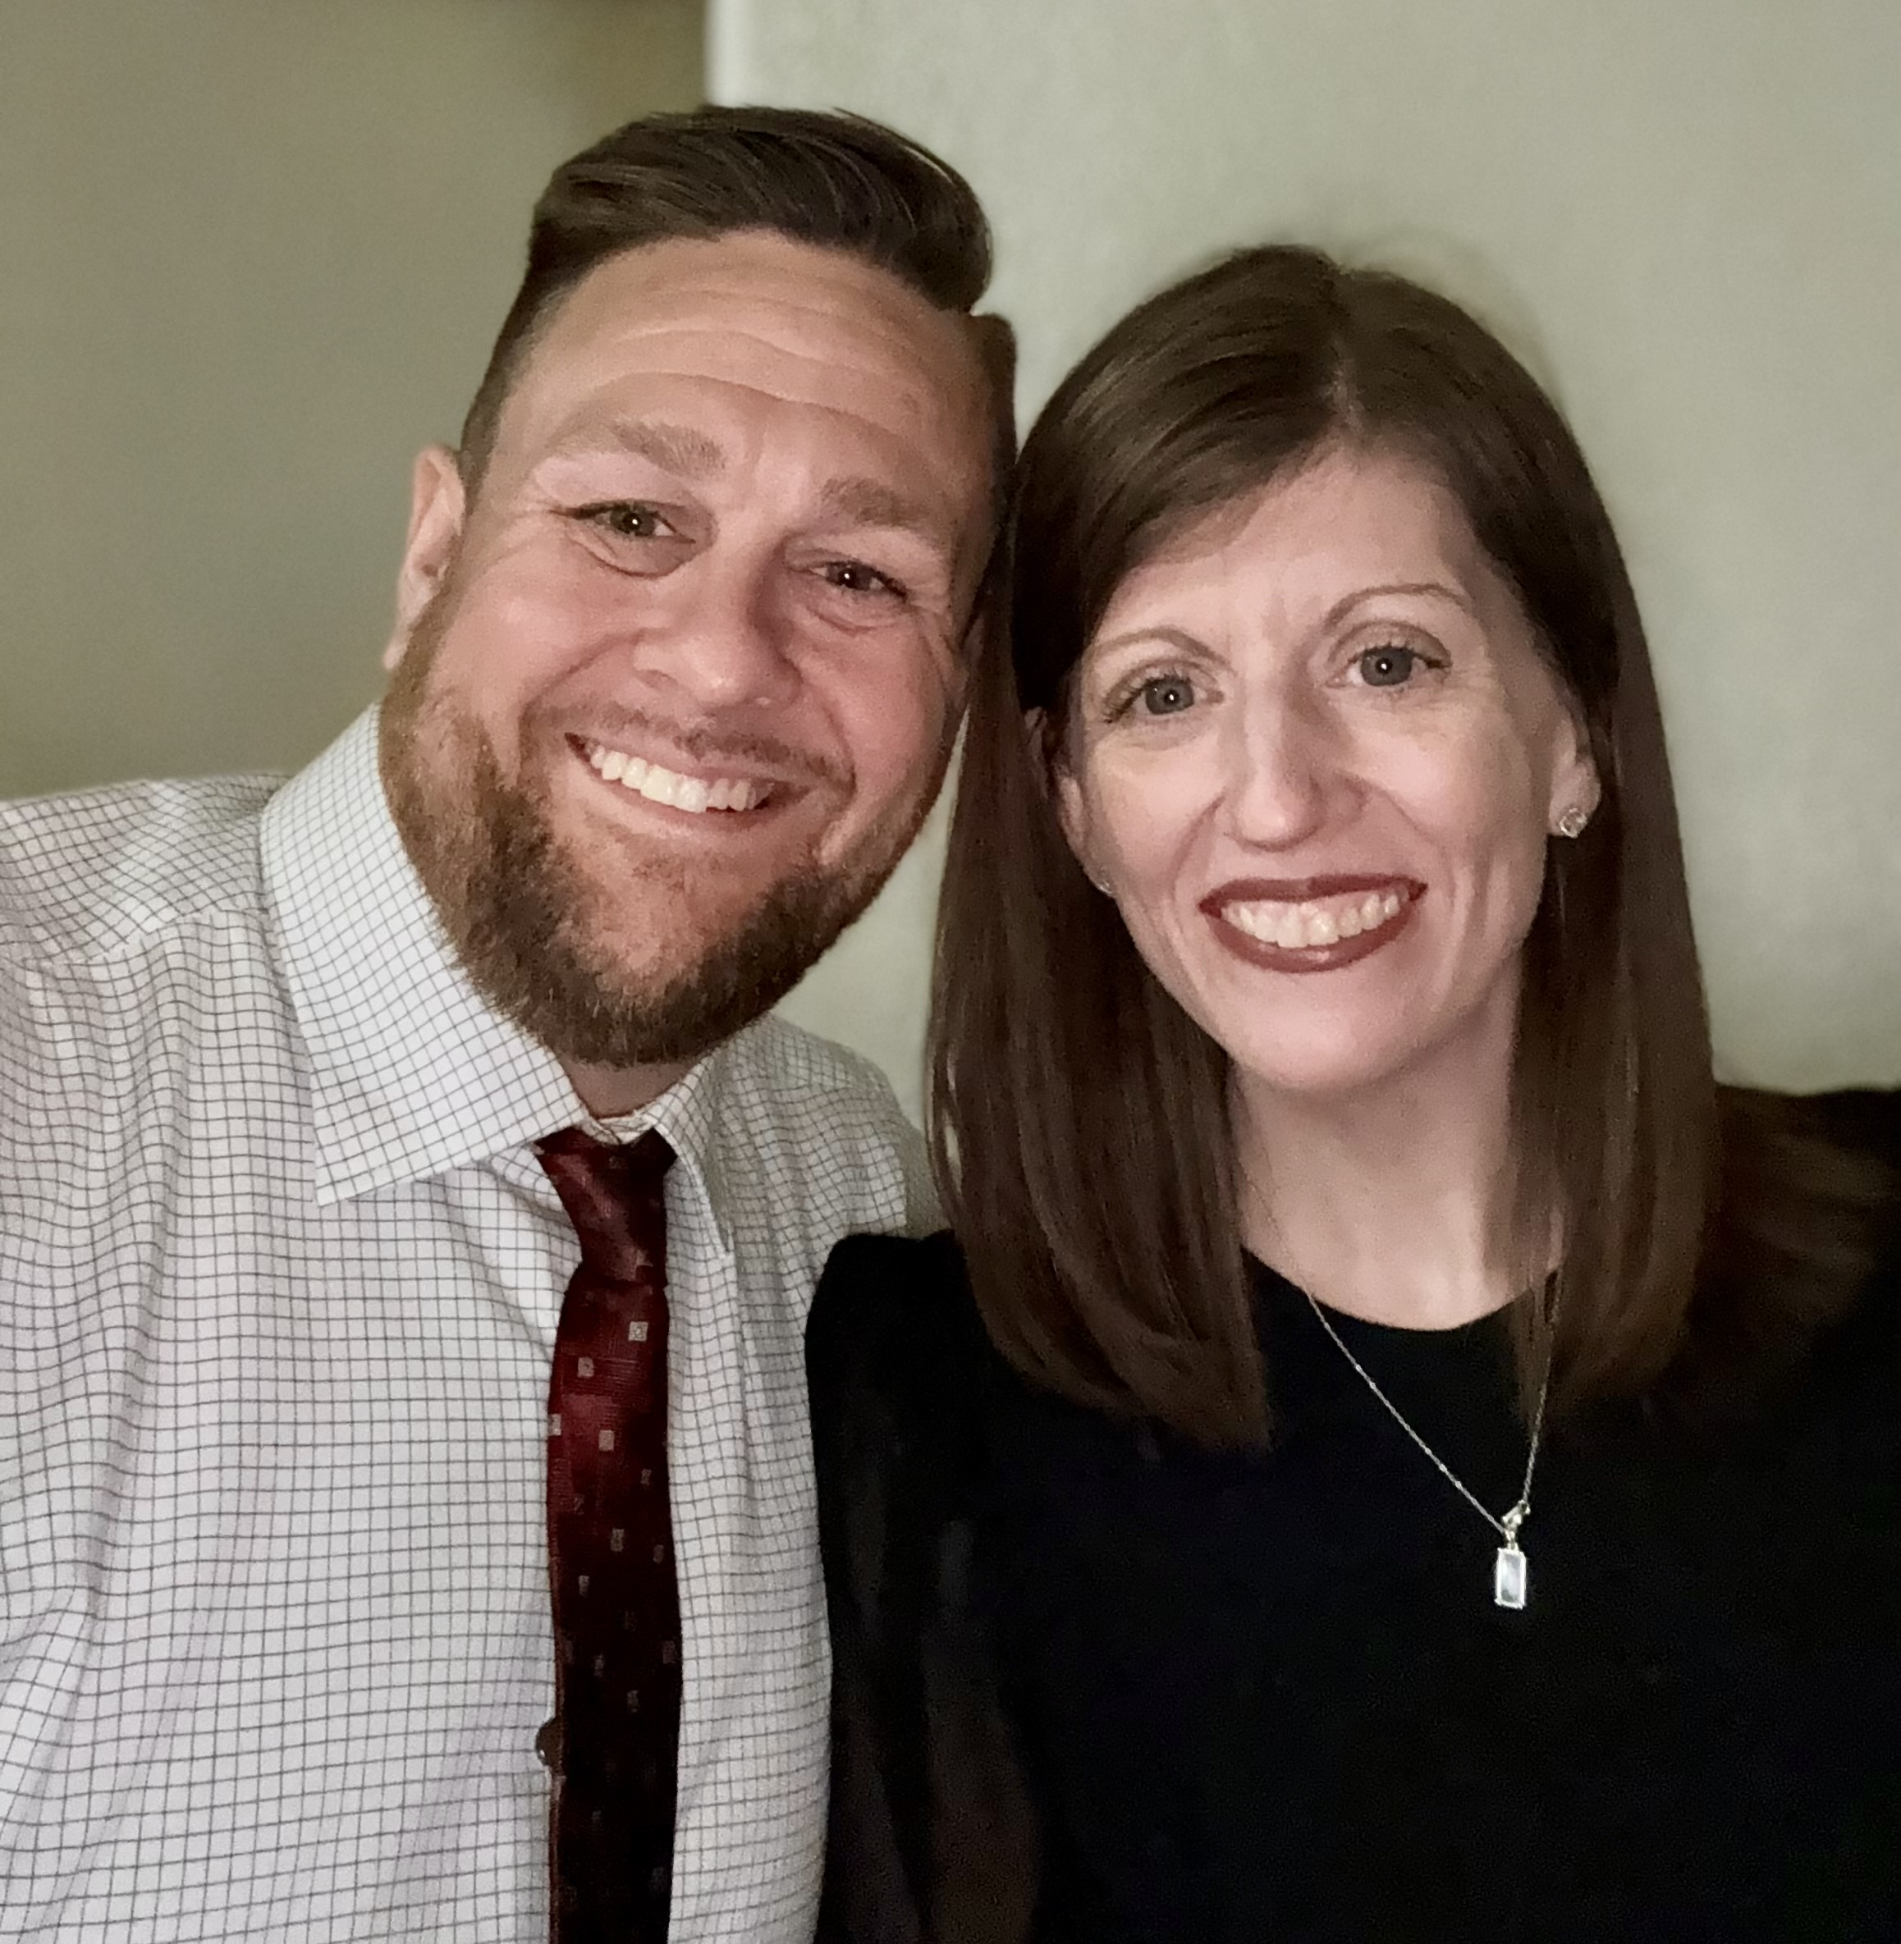
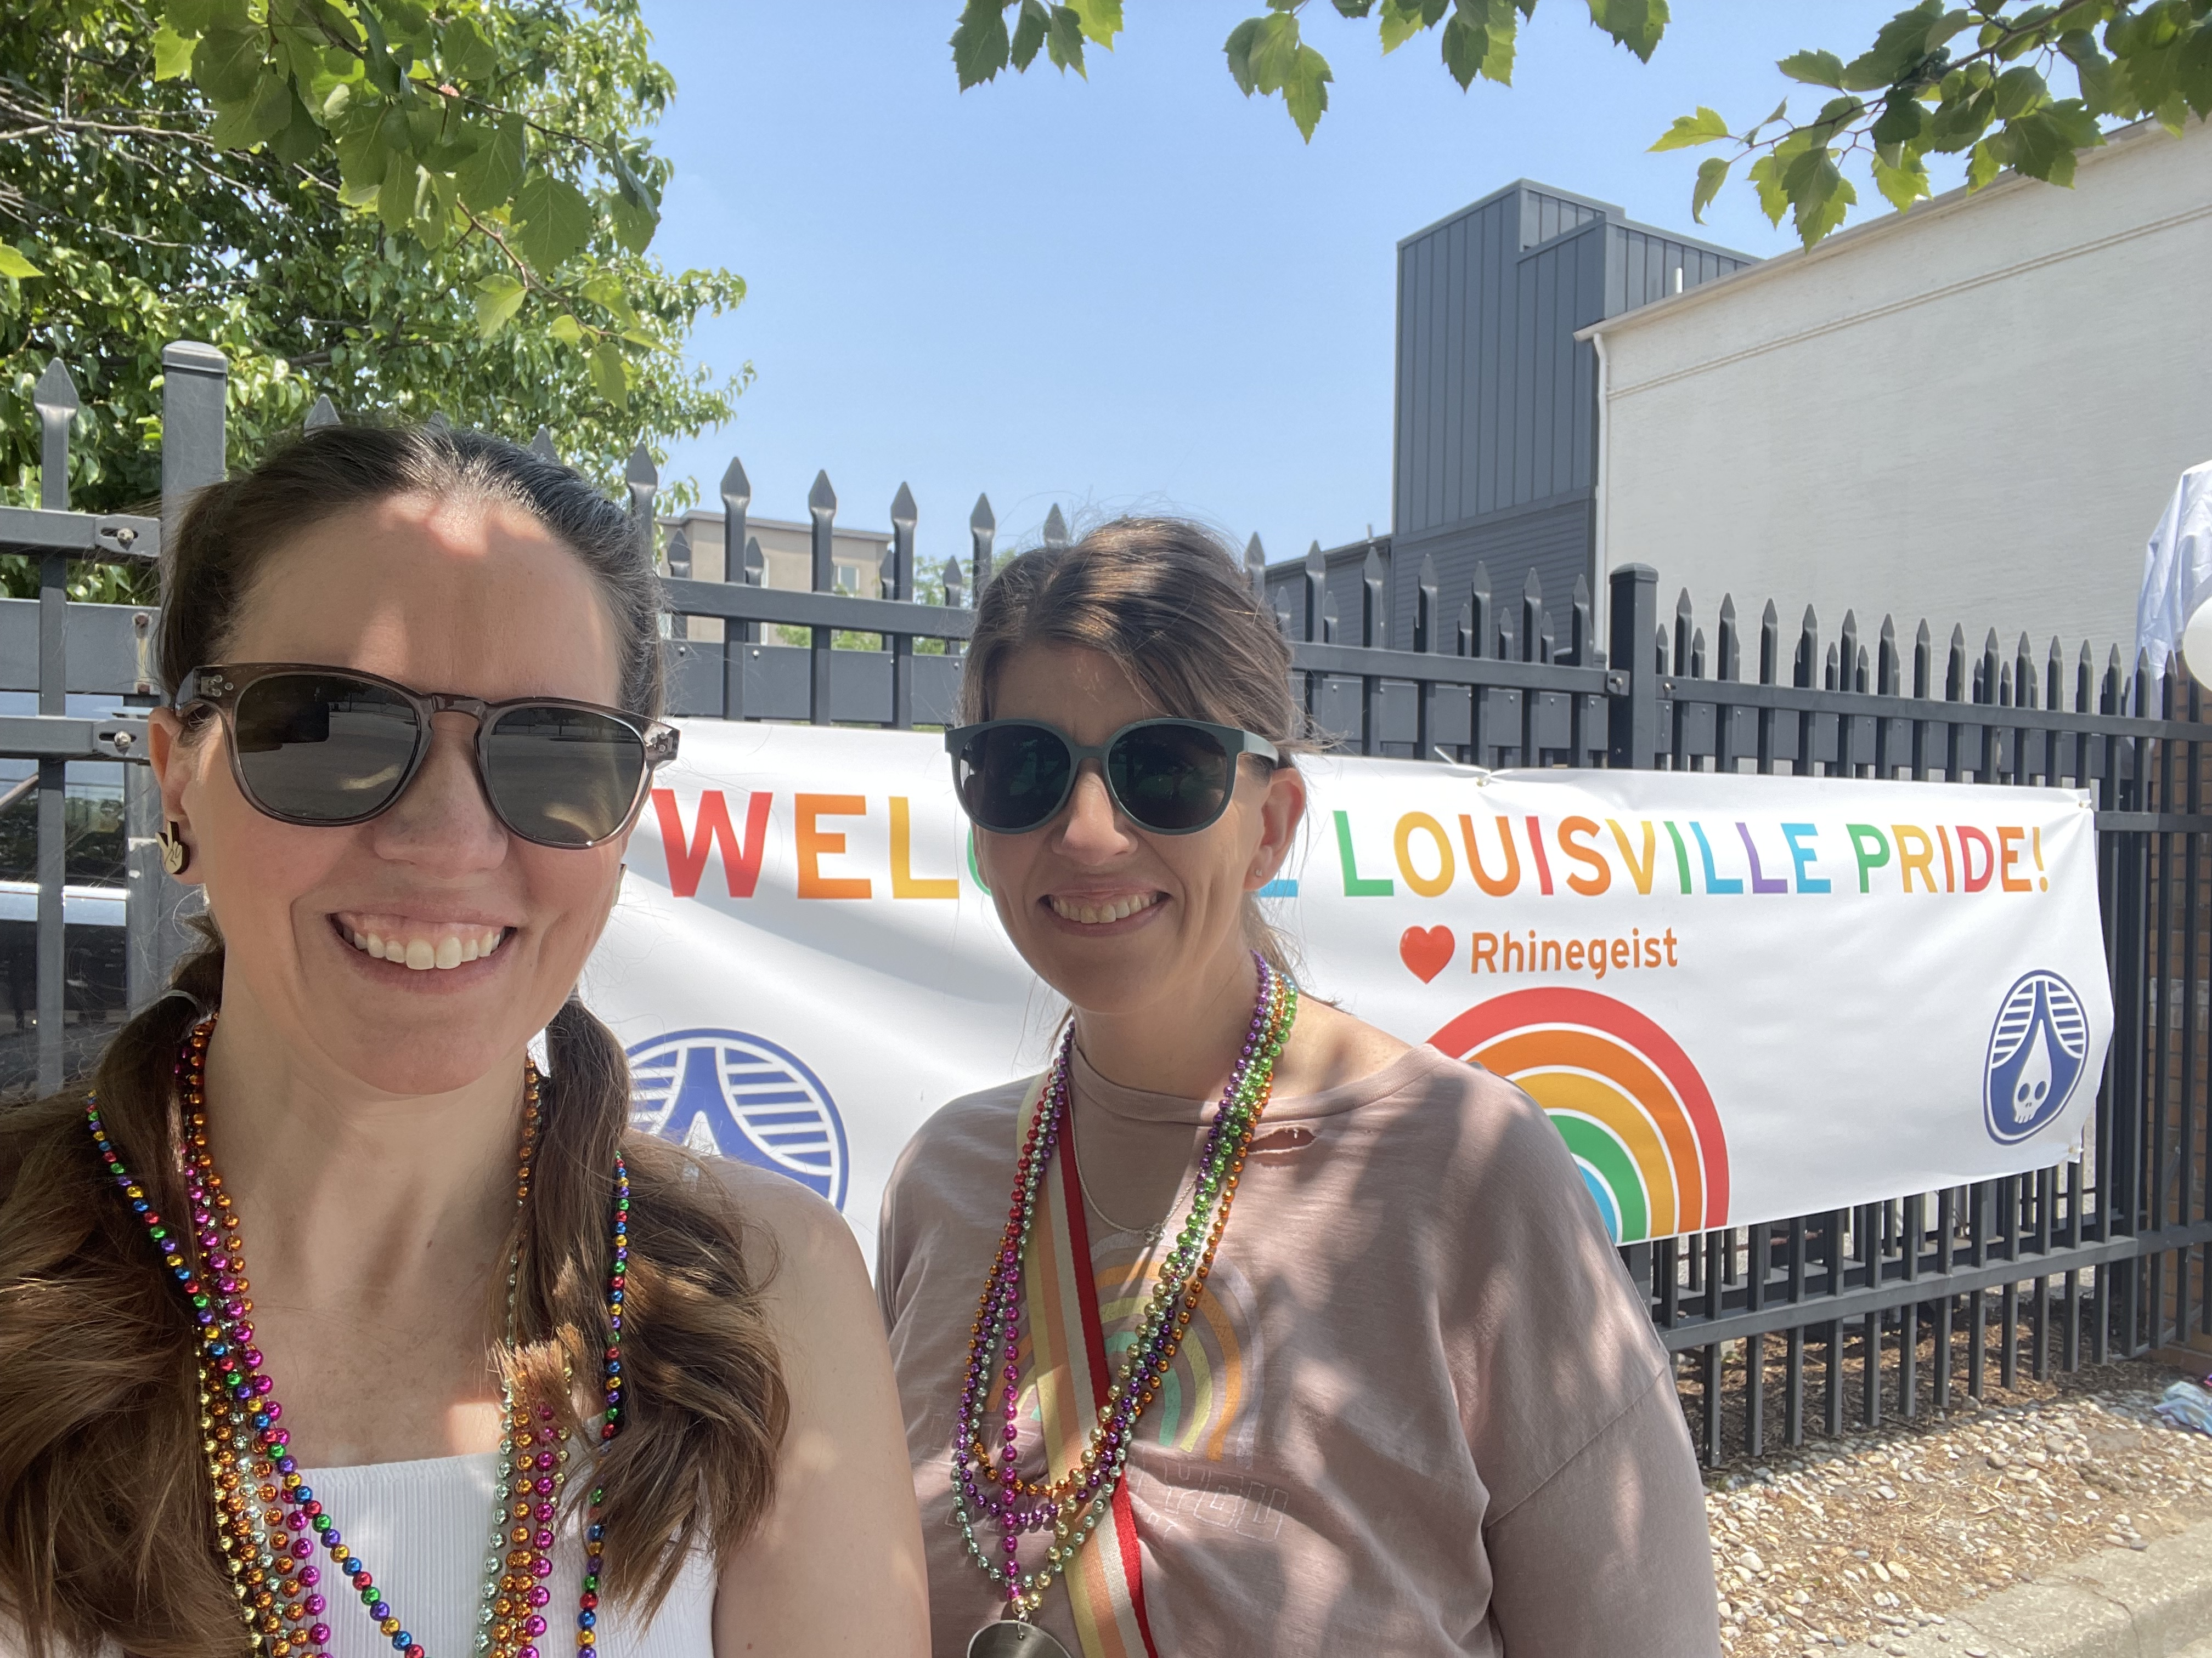
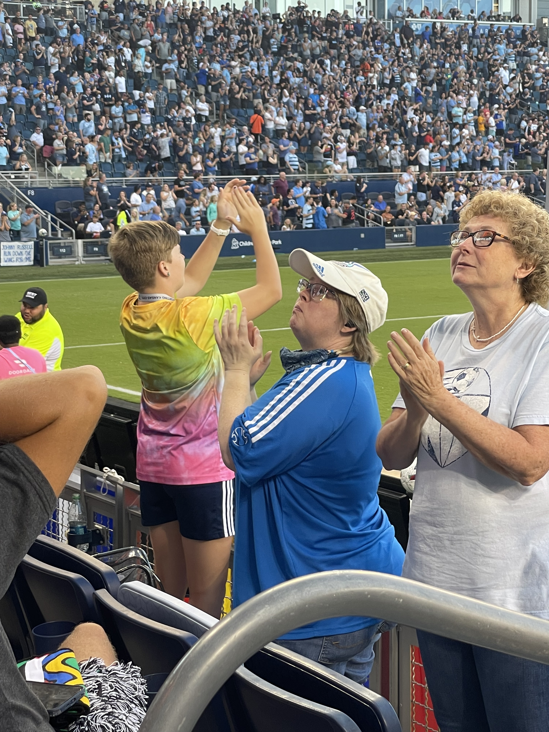
Gender Identity
I identify as a cisgender, straight woman. While this identity gives me social comfort in many settings, I’ve seen others who did not have the same experience or sense of belonging. That compels me to be an active ally and to ensure my classroom is a safe, affirming, and inclusive space for all gender identities and expressions.
My husband and me at a wedding in 2025!
My best friend and me at Louisville (KY) Pride in 2022!
Another reason I will always support all people; watching my kid cheer on a soccer game; being their authentic self!

Slide 7
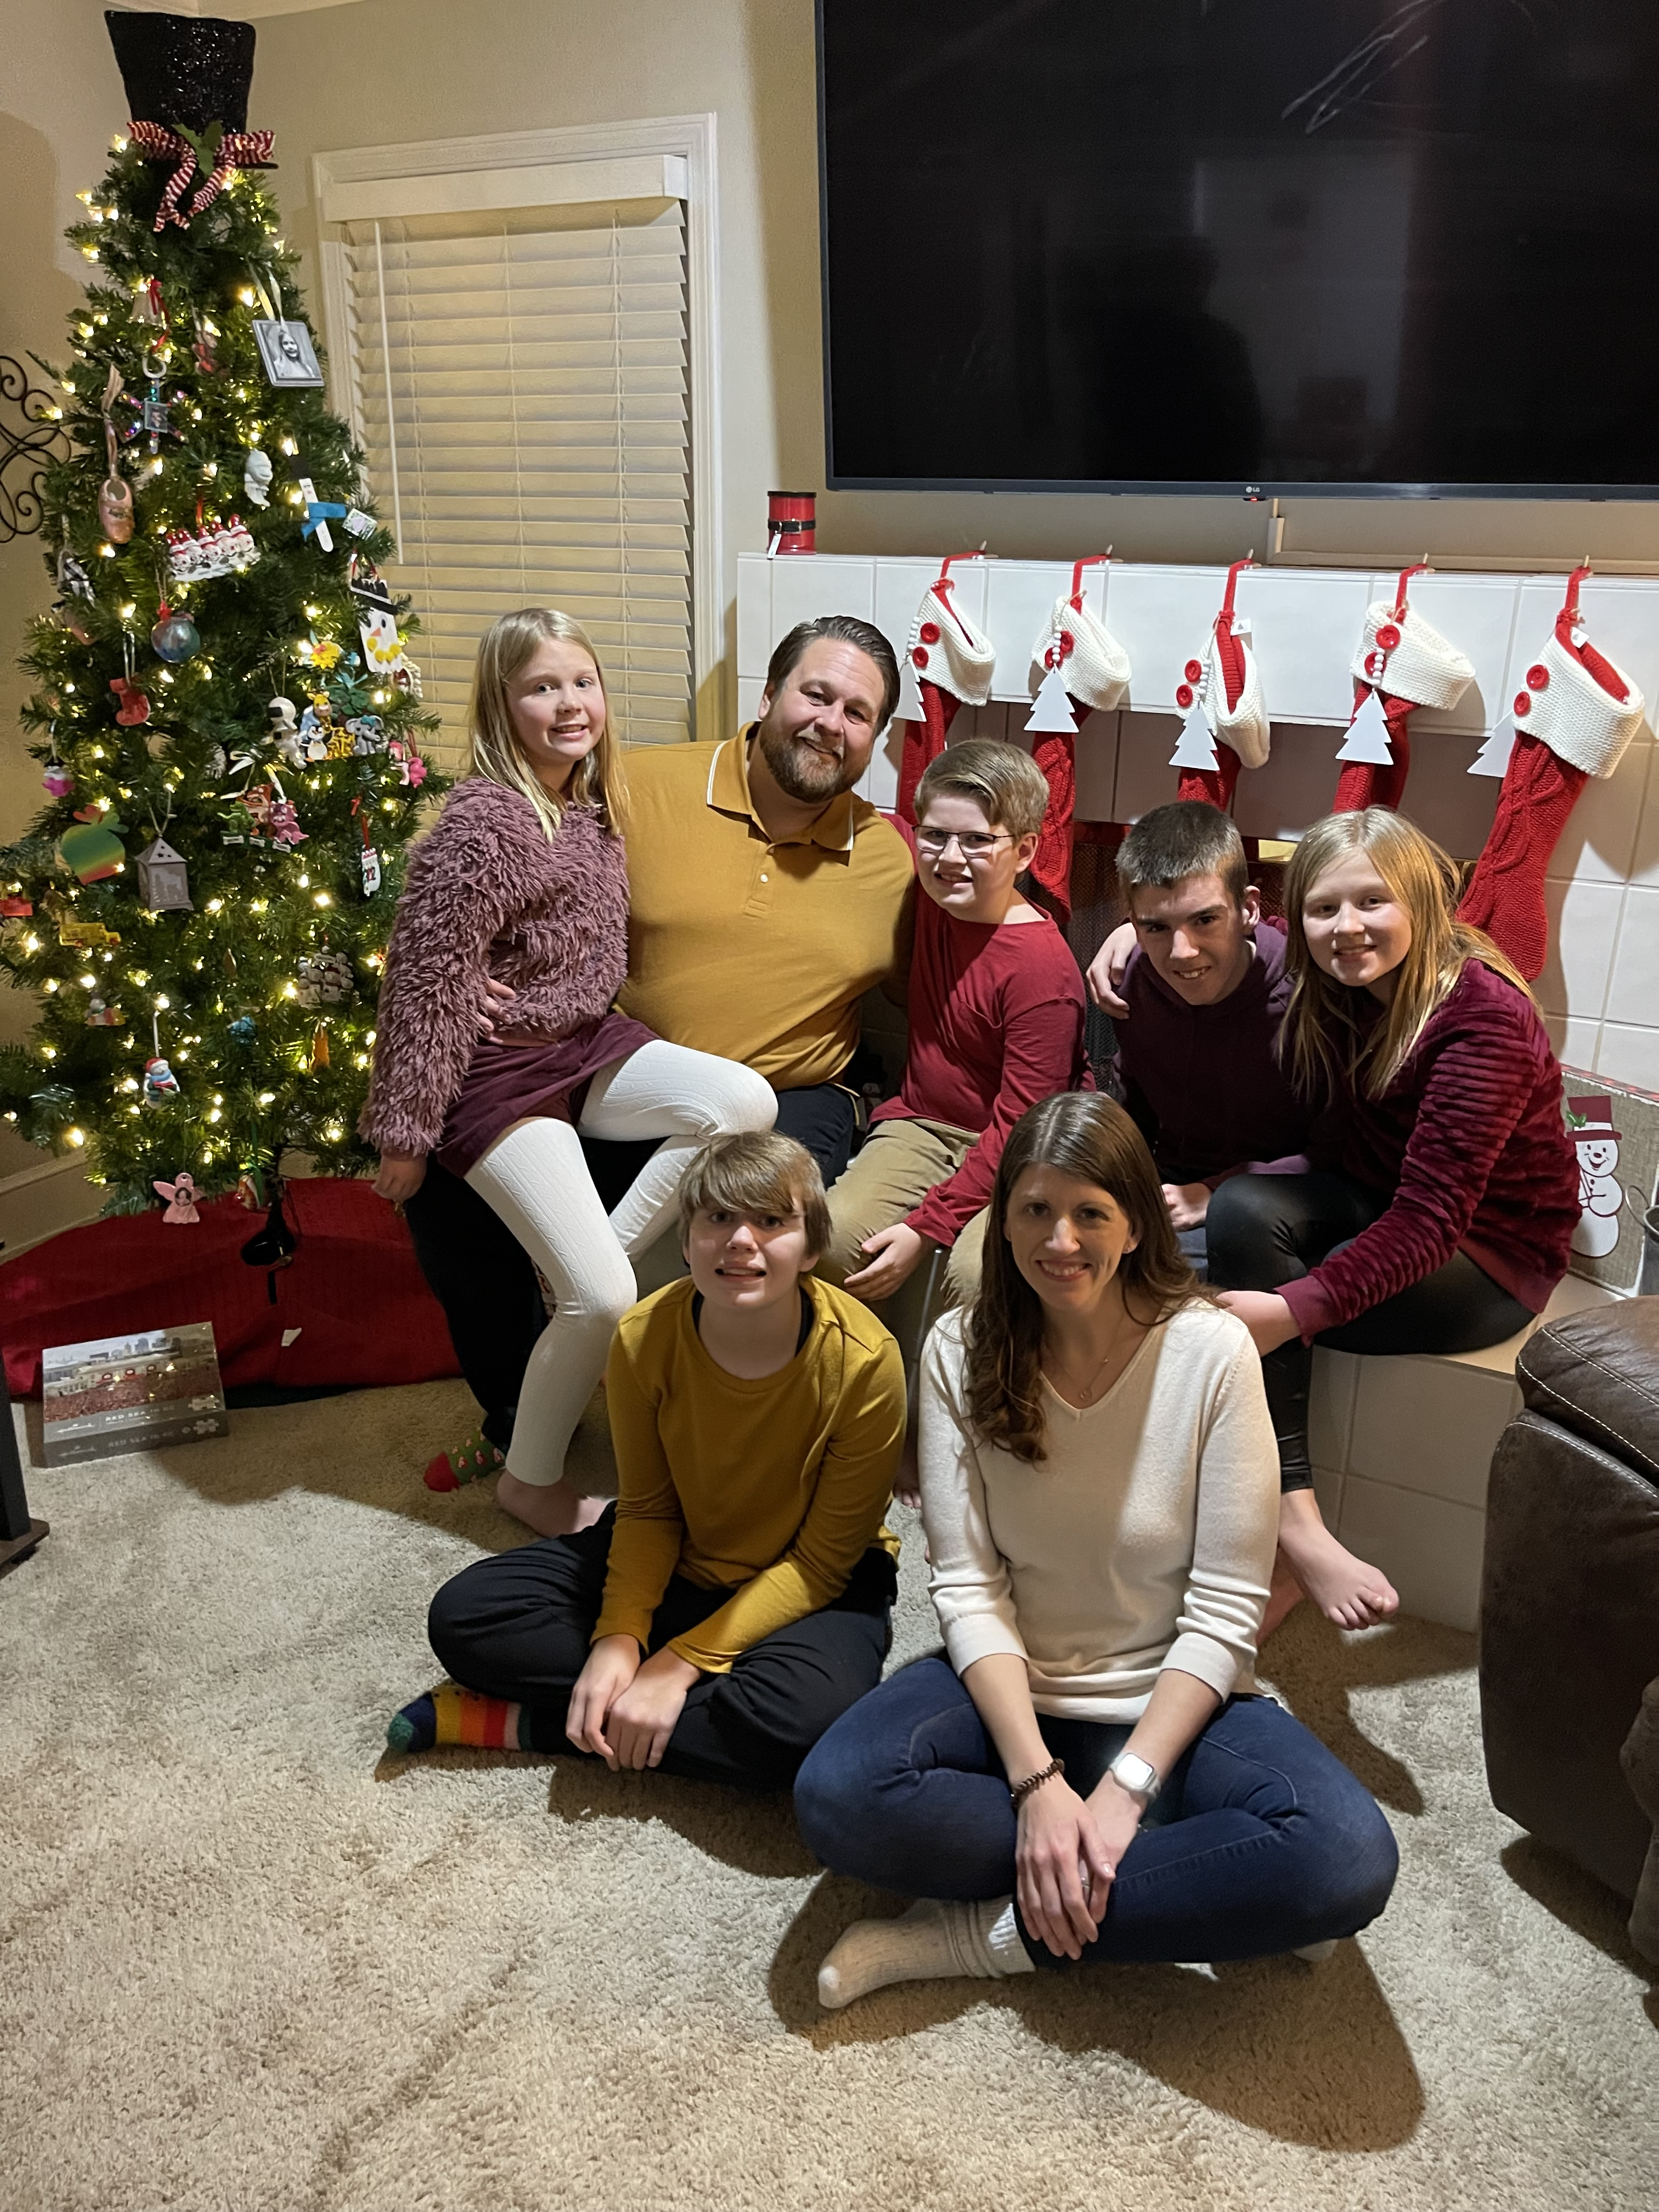
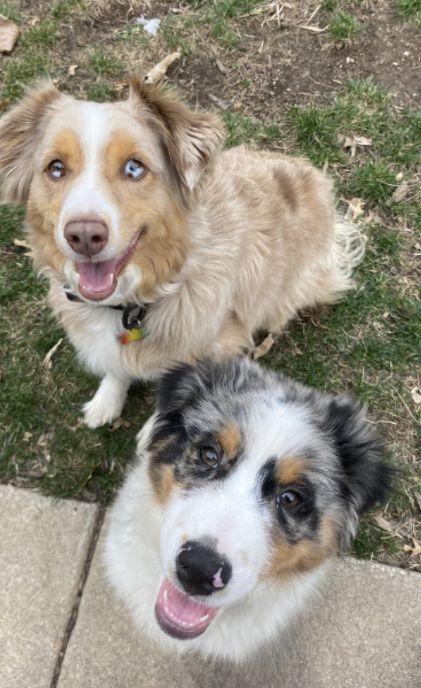
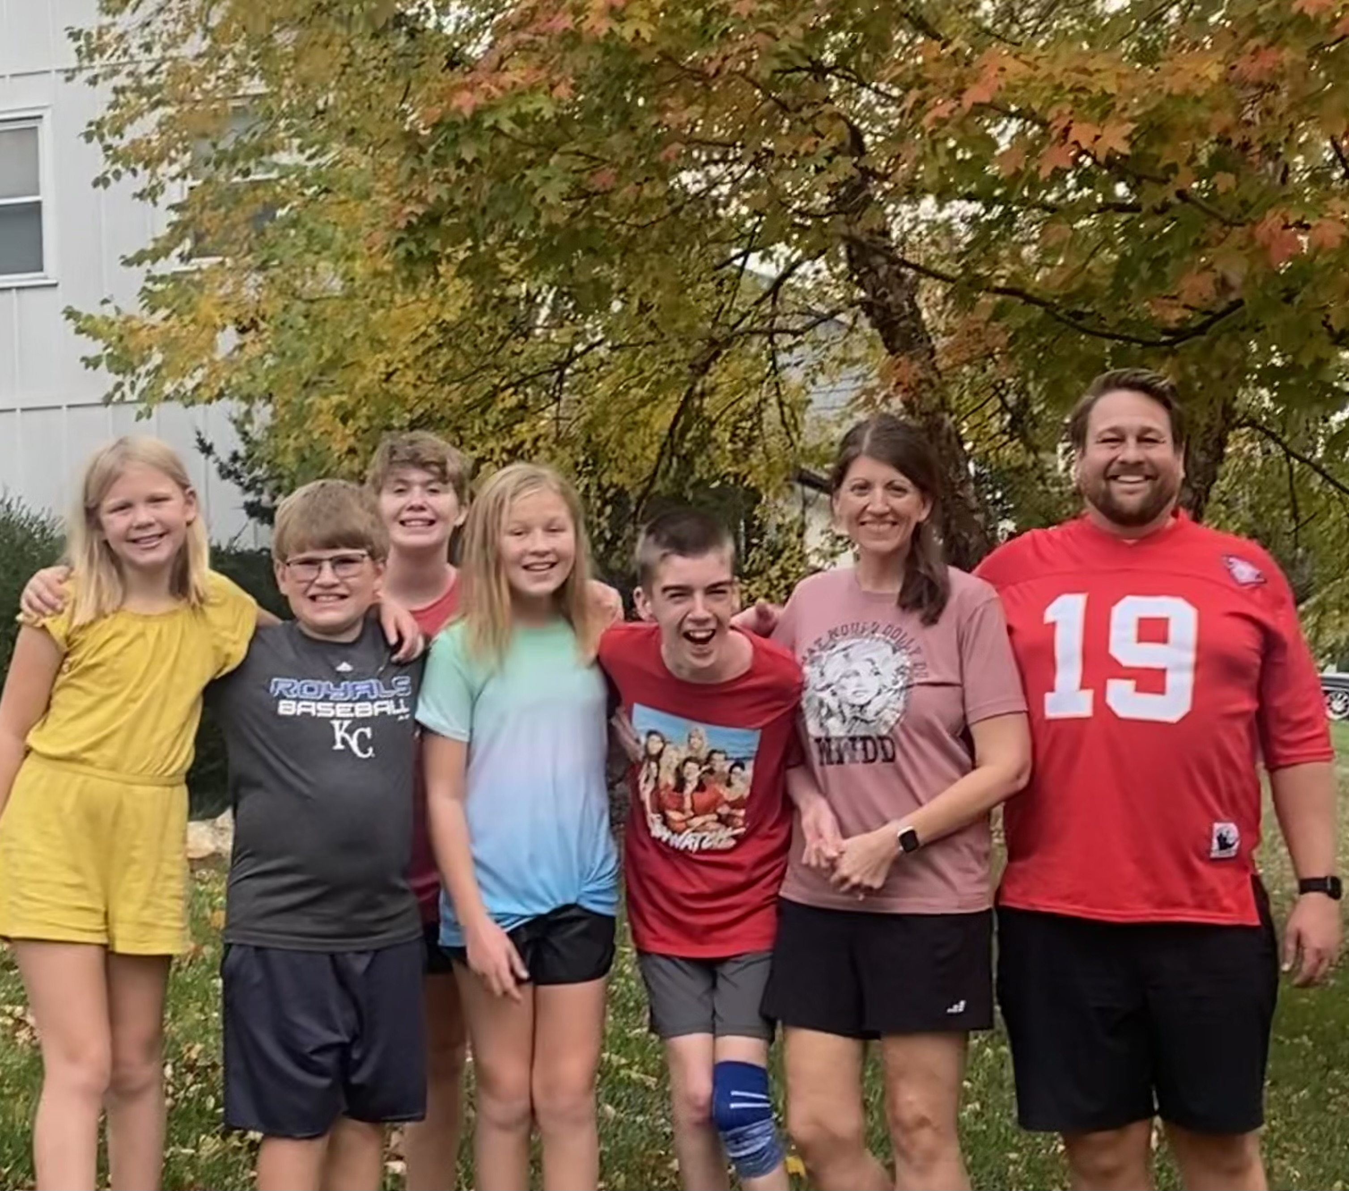
Parental Status
Being a parent has deepened my empathy, patience, and understanding of how every child learns and experiences the world differently. Having a child with special needs gives me an even deeper insight into the challenges families face and the importance of individualized support. This perspective shapes how I approach both teaching and collaboration — with compassion and flexibility at the core.

Slide 8




Work Background
My work experiences have taught me valuable collaboration skills, like active listening and teamwork. I bring these skills to my teaching practice to encourage cooperative learning.

Slide 9
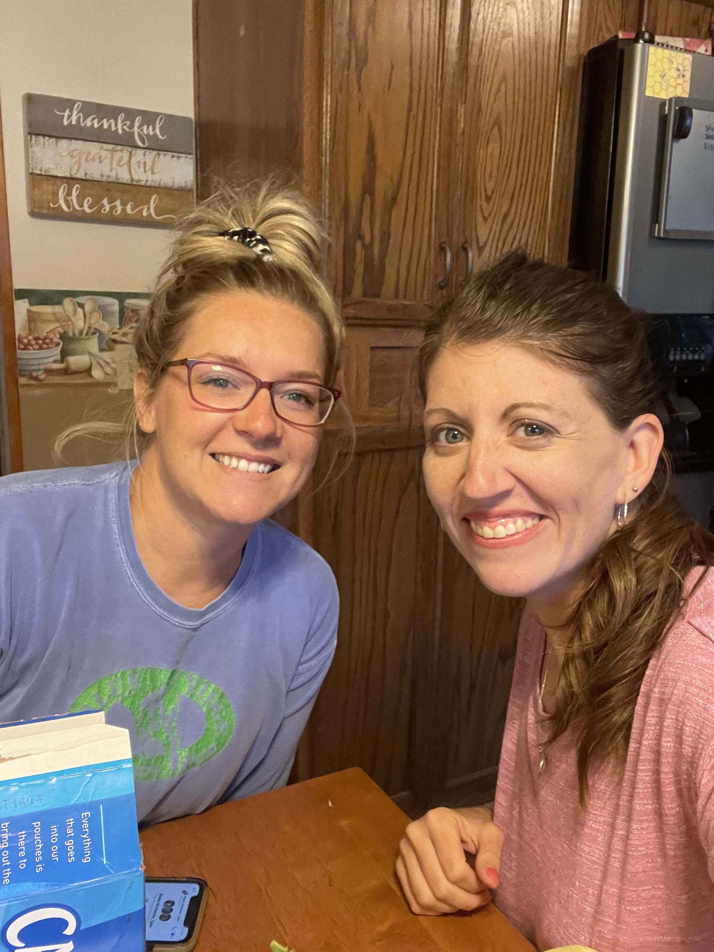
Bringing My Full Self to the Work
Reflecting on my identity through the lens of the Identity Wheel has helped me better understand how my lived experiences shape who I am — not just as a person, but as an educator, colleague, and advocate. Each part of my identity, whether visible or not, brings both perspective and responsibility.
Some aspects of my identity — such as being a straight, cisgender woman, or having access to education — offer me comfort and privilege in many environments. Others, like parenting a child with special needs, give me insight into the barriers and advocacy needed within schools. These intersections influence how I approach collaboration: with empathy, openness, and a deep belief in inclusion.
As I continue to grow as an educator, I recognize that identity is not static. It's evolving — shaped by relationships, reflection, and learning from others. By bringing awareness of my own identity into my teaching, I can be more intentional in creating inclusive spaces where all students and colleagues feel seen, valued, and empowered.

