Slide 1
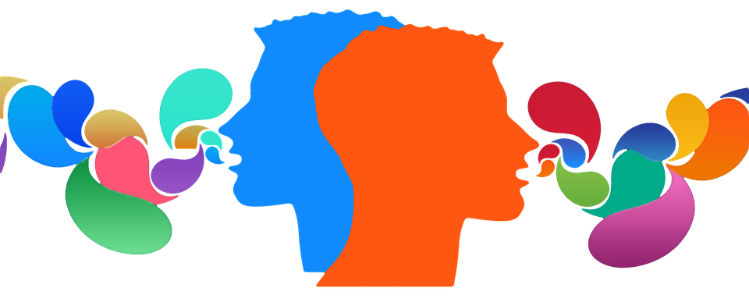
Strengthening Our Communication and
Collaboration Practices
Erica Grindinger
SPED 854: Professional Development Presentation
University of Kansas
Dr. Griswold
Link to video presentation to follow along:
CLICK HERE!

Slide 2

Understanding the Foundations
Interpersonal - The way we interact with others: verbally, nonverbally, and through active listening.
Examples: Body language, facial expressions, and tone of voice to convey messages. Email, text, phone calls, social media, etc.
Intrapersonal – How well we understand our own values, triggers, and communication preferences. (Think communication you have with yourself.)
Examples: Meditating Self-reflection, goal setting, visualization and self-talk. Could even be considered writing in a diary or praying.
Notes:
.

Slide 3

TAKE NOTE…
We can’t effectively collaborate with others unless we are also aware of what we personally bring to the table!

Slide 4
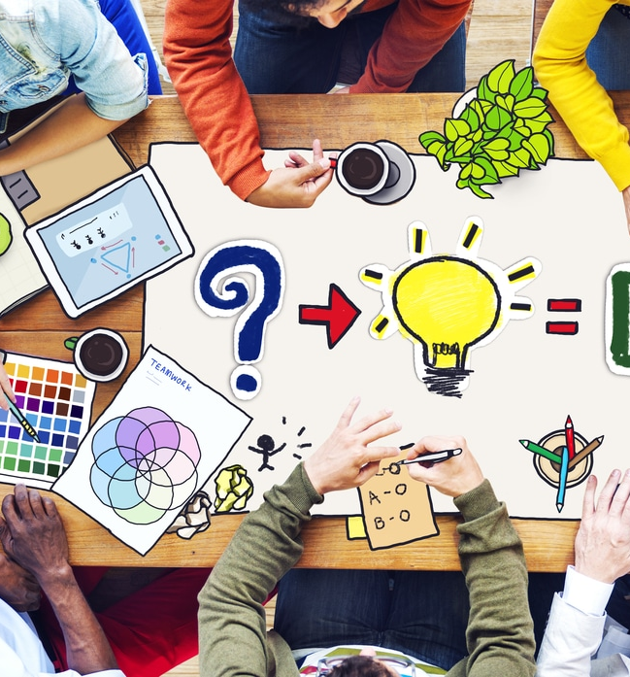
Key Collaboration Concepts
Four practical concepts that can enhance our day-to-day communication and collaboration:
Parity – All participants should feel equal in value and voice, regardless of their role. Whether it's a general education teacher, a specialist, or a paraprofessional, everyone’s expertise matters.
Voluntary Participation – While collaboration is sometimes mandated by structure, effective collaboration requires buy-in. Creating an environment where team members feel invited and safe to contribute fosters stronger outcomes.
Shared Responsibility – This means shared planning, decision-making, and ownership of results. It's not about whose job it is—it's about what we can accomplish together.
Shared Accountability – We celebrate together when things go well, and we problem-solve together when they don’t. That collective approach builds trust and resilience.

Slide 5
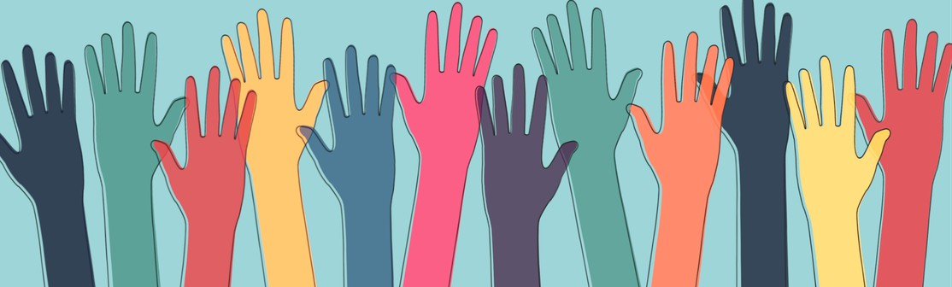
Why Proactive Collaboration?
A proactive mindset allows us to:
- Anticipate student needs with input from multiple perspectives.
- Establish clarity in roles and expectations.
- Foster more responsive, rather than reactive, solutions.
When we build collaboration into our culture—not just our crisis responses—we create systems that support inclusion, equity, and consistency for all students!

Slide 6
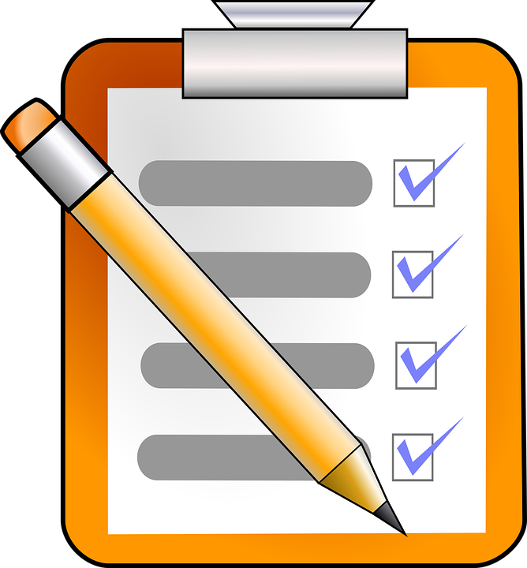

Practical Suggestions
Things that can be done right now to strengthen communication and collaboration:
Use intentional language.
  Be clear, concise, and respectful in verbal and written communication.
Practice active listening.
  Allow colleagues to finish their thoughts without interruption and paraphrase their points to show understanding.
Check assumptions.
  Our own experiences shape how we interpret others. Ask clarifying questions rather than jumping to conclusions.
Schedule time for collaboration
  Real collaboration can’t be an afterthought squeezed into transitions. Protecting time shows it matters.
Reflect regularly.
  Take time to ask yourself, “How did I show up as a teammate this week?” and “What could I do better?”

Slide 7
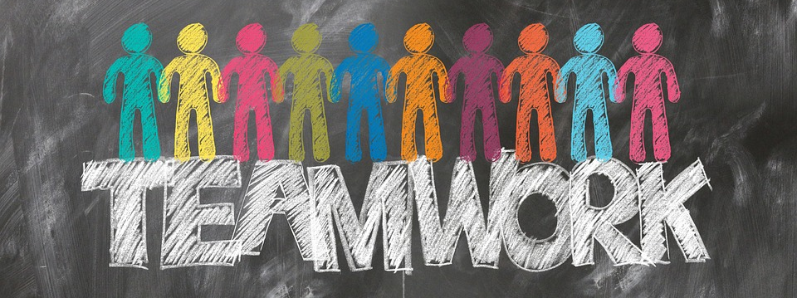
Strong teams don’t happen by accident.
They’re built through honest conversations, mutual respect, and shared commitment to student success.

Slide 8
References
Friend, M. (2021). Interactions: Collaboration skills for school professionals. Boston, MA:
Pearson (Chapters 2, 3, and 4)

